Slide 1


Foundations of
Scientific Computing
Dave Biersach
dbiersach@bnl.gov
Task 02
Lowest Common
Multiple

Slide 2
Task 02
Write a Python program called lcm_gcd.py to calculate the lowest common multiple (LCM) of two integers
You may only use basic arithmetic operators - no looping constructs, such as a for loop
You may also leverage the Numpy greatest common divisor (GCD) function
Calculate and display the LCM of 447618 and 2011835

Slide 3
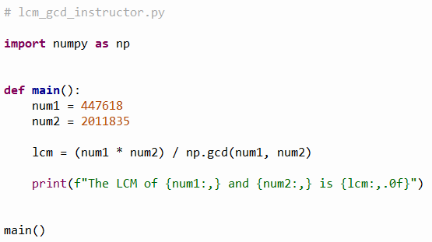
Open lcm_gcd_instructor.py
①
②
③
④
⑤

Slide 4
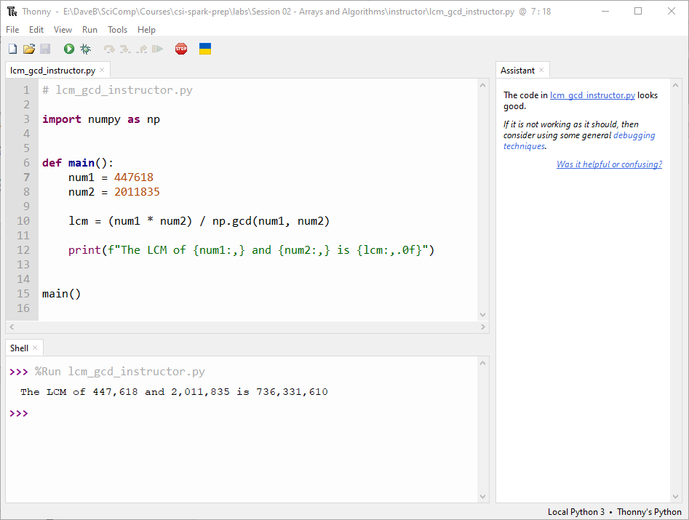
Run lcm_gcd_instructor.py

Slide 5
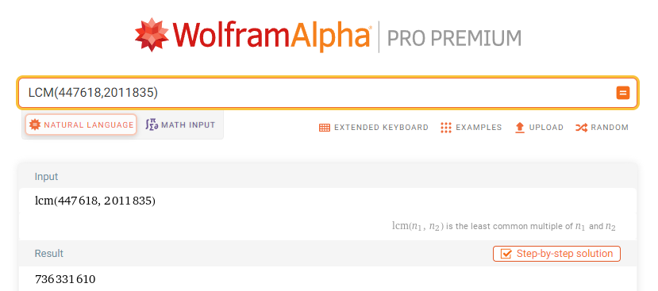
Run lcm_gcd_instructor.py

